Slide 1
TCS Real Estate Capability Overview
September 2014

Slide 2
TCS in Real Estate | Fact Sheet
Key Facts
450+ Highly qualified Real Estate professionals
14 Real Estate clients with many in top Fortune 500
Global presence – 15 Global delivery locations
Presence across all Real Estate functions
BPO - More than 20 Languages being serviced across globe
Center of Excellence for Real Estate
Proven capabilities in Real Estate Business Process, IT Products and Services

Slide 3






TCS Real Estate Services | Overview
Experience
People
Alliances
Presence across Developers, Owner Managers, Investors, Property Managers Residential, Relocation Services & Tenants
Client presence geographically across US, UK, APAC and Continental Europe
450+ highly experienced consultants providing services to the Real Estate Industry
Dedicated Center of Excellence for Real Estate & Relocation Services
Diamond Partner and Global Systems Integration Partner of Oracle
Premium Partner of Choice for IBM Tivoli Products
Alliance with niche partner for customized domain expertise and strategy for access to RE thought leadership
Active Clients across Real Estate IT and BPO Services delivering services on
Vision
“To be recognized as the world’s leading business solution provider and the partner of choice to our worldwide clients for their Real Estate Needs”
CTI
Yardi
MRI
JD Edwards
Argus
SkiRE
AMT Direct
Tririga
Maximo
Engagement Snapshots
Delivery
Services Offered
End to end IT systems enhancements and support for one of the largest US based Real Estate investors with operations in North America, Europe, Asia & Australia
Global PeopleSoft HCM implementation and maintenance for commercial real estate services firm with operations in 60 countries with over 15,000 employees
Property accounting & lease admin services for a large APAC based developer, fund manager and property manager of commercial real estate
Global program & delivery management
Localized solutions with multi-language functional capabilities
Domain coverage with strong focus on Real Estate
Global Network Delivery Model™ with 15 delivery centers across the globe
IT Systems Development, Implementation, Maintenance & Support
New technologies – Mobility, Connected Marketing, Big Data, Cloud Computing
Business Process Outsourcing
Consulting & Strategy

Slide 4
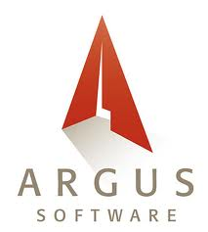








TCS Real Estate | Capabilities
Brokerage Management
Property Management
Asset Management
Brokerage Management
Property Listing
Property Sales
Contact Management
Brokerage Fees
Lead & Open House Management
Property Management
Lease Administration
Tenant Administration
Cash Management
Lease Accounting
CAM Reconciliation/Audit
Asset Business Plans
Hold/Sell Analysis
Returns Analysis
Returns/Sensitivity Analysis
Development Modeling
Disposition Analysis
Offering Memorandum
Valuation and Advisory
Relocation
Advisory
Strategic Planning
Valuations
Market Research
Appraisal Reviews
Initiation
Transportation
Home Sale
Visa & Immigration
Cost Management
Facility Management
Construction
Facility Management Helpdesk (Tenant Helpdesk)
Preventive Maintenance
Vendor Management
Contract Management
Tenant Satisfaction Survey
Site Management.
Labor Management.
Equipment Management
Quality Management
Civil/Structural/Architectural design

Slide 5
TCS Capability | Process and IT Landscape
PM System
BI & Reporting
B&F*, AM**
CRM, BPM
ECM & Doc Mgt
Other Solutions
Asset Maturity in Real Estate Life Cycle
Leasing Stage
Pipeline Mgt
SF CRM
MSD CRM
Dyna
Lease Analytics
Lease Mgt
Lease Administration
Lease Administration
Cash Management
MRI
Billing, Receivables, Collections
Tenant Coordination
Building Administration
Construction Management
JDE
SkiRE
Purchases, Payables, % Rent
Purchases, Payables
Contract Administration
Facilities Management
Steady State
Tenant Administration
Capital, Job Cost Accounting
Budgeting & Accounting
CTI
Forecasting, Re-forecasting
Archival & Storage
Relocation
Financial Reporting
Valuations
PS CRM
Management, External Reporting
Strategic Asset Stage
Advisory
Acquisitions, Dispositions
Acquisitions, Dispositions
Strategic Planning
Essbase
* Budgeting & Forecasting ** Asset management

Slide 6
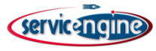
TCS Real Estate Clients | Success Stories
A leader in Investment Banking, financial services, Commercial banking, Asset Mgmt and Private Equity
Largest Arts & Crafts Retailer with over 1,100 stores in North America
A leading global provider of real estate and relocation services, technology and knowledge
One of the largest Mall Owners in the US
Consulting
IT
Residential
Investors
Global financial services firm (Bank) with close to $700 billion assets under management
UK based real estate adviser with operations in more than 40 countries
Tenants
Owner
Managers
Property
Managers
Commercial Real Estate Broker and Consultant with a global footprint
A leading financial services organization with $453 billion in assets under management
BPO
Maximo
Largest privately-owned real estate company in US with over 15,000 agents in the Mid-Atlantic
One of the largest Asset Managers of Commercial Real Estate across the world - North America,
Europe & Japan

Slide 7








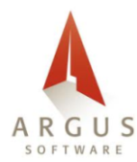





Real Estate Products | Alliance and Partners
Alliances and Partners
Gold Certified Partner
Strategic Partnership with Microsoft
One of 14 Global System Integrators worldwide
Global Services Partner
Partnership in transformational initiatives of our strategic clients
Global CoE
Proven capability to conceptualize, architect, deploy and maintain large and complex solutions on the Oracle platform.
Top three partners with the maximum number of certified consultants on Salesforce.com, globally.
TCS Center of Excellence.
Niche consulting & partnership in business structure.
Technology in line with Real Estate industry
TCS Global Alliance
TCS and IBM have been long-standing partners in bringing enhanced value to their customers.
Tivoli suite of products Tririga & Maximo

Slide 8







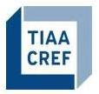


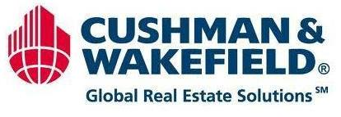





Real Estate Engagements | Business Process View
Residential and Commercial Real Estate
Real Estate IT Services
IT Infrastructure
Global Consulting
Asset Based Solutions
Business Process Outsourcing
Property Management
Lease Administration
Billing and Rent Management
Accounts Management
Brokerage management
Payables
Valuations & Real Estate Analytics
Subcontract Management
Finance Integration (AP, AR, GL)
Real Estate Property Search
Consulting for Real Estate Platform
Quality Assurance Testing
Relocation Services
Relocation Estate IT Services
Application Development and Support
Legacy modernization
IT Infrastructure
BPO Application Service Desk

Slide 9
TCS Real Estate Engagements | IT Services View
IT Services – Application Development & Support
BPO Services
Consulting Services

Slide 10
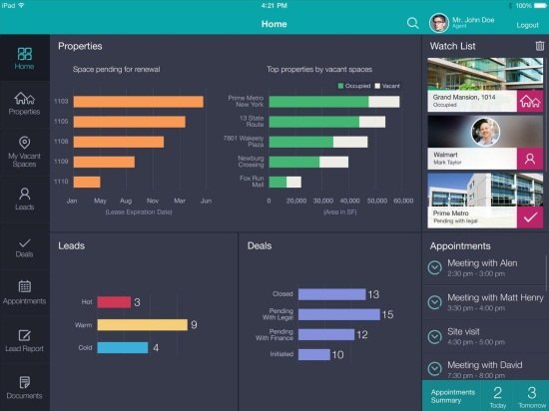
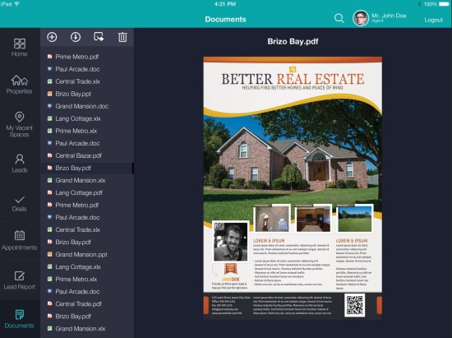
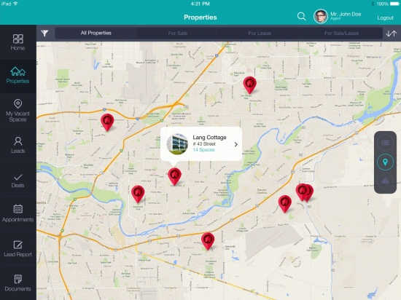
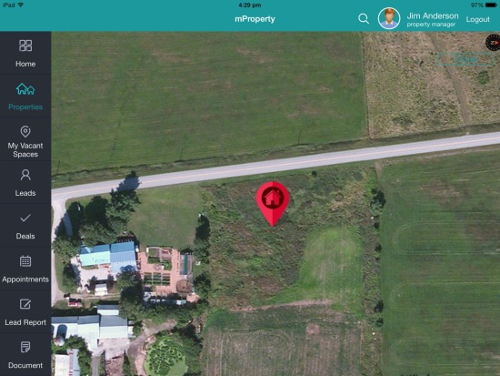
TCS Real Estate Mobility Solution | Accelerator
Intuitive Design That Saves Your Time
Advanced Management
Win More Customers
One-Stop Solution
Intuitive User Interface
Uniquely designed home page provides access to all the important information on one page and through a single click.
One Click Overview
Snapshot of the Properties, Spaces, Leads and Deals.
Lead Management
Easily track, manage, organize and prepare reports for leads
Data Management
Quick access to property, space, deals and documents through advanced sorting and filter options
Market Comparison
Comparison of recent deals closed in a selected region or neighborhood through integration with external database.
Demographic Profile
Demographic profile of the selected region or neighborhood through integration with external database.
Backend Agnostic
Ability to easily integrate it with existing real estate and CRM systems.
Social Media Integration
Integration with Google Maps, Email, Chat, Video Call and other social media
Property Management Tools
CRM/Lead Management
Organizer
Document Management
Collaboration Tools
Vacant Space Management
Deal Tracking
Advanced Search

Slide 11
TCS Real Estate Clients | Success Stories
 | Argus Implementation , support for real estate division of an American multinational conglomerate corporation | CTI Support for Real Estate Investment Management Arm of Leading Global Bank | Yardi Implementation, support for One of the Largest Asset Managers in Commercial Real Estate | Project development, Support and Maintenance for global provider of real estate and relocation services
Relationship | 15+ Years | 7+ Years | 7+ Years | 10+ Years
Highlights | 500+ users Support across NA, Europe, and Asia | 250 users CTI 8.8 ( Contains property information, accounting, leasing, and tenant profile) | 135 users (115 property managers, 20 in house users) Yardi hosted by vendor, Argus hosted in house | 1350 Internal Users Presence across ADM, Service desk, and IT infrastructure services
TCS Service Profile | Due to increasing volume of data and business expansion, the client decided to move from Dyna to Argus TCS implemented Argus, migrated data from Dyna to Argus, Integrated Argus with Main Asset Management Solution (Atlas), integrated with downstream systems and reporting solutions | CTI is used to manage, operate, track & service each property and to do the right accounting TCS provides end to end support for the application maintenance and enhancement of the CTI application and its downstream & reporting systems | Property managers had different property management software such as MRI, CTI etc. Client decided to create a unified solution for all its property managers and decided to implement Yardi TCS has been involved in Yardi implementation, upgrades, Customization, 1st Level support, reports development | TCS has been involved in development and maintenance of ongoing customization and changes in the existing real estate and relocation applications. Service desk operation for client’s relocation business. Support for client’s valuation & advisory business
Key Benefits to Customer | 30% cost savings leveraging Onsite Offshore Model for the project. Rapid ramp-up of offshore team. Leveraged knowledge & competency from TCS Real Estate CoE & other Projects on need basis. | Reduced operational cost with innovative solutions, tools and services. Delivered within the budget and quality, always met/exceeded expectations | TCS provides phone/email support which enables client to get queries resolved quickly. Effective coordination with product vendor has resulted in decreased turn around time for issues. | Proactive suggestions to improve operational efficiency TCS has created multiple tools and methodologies suited for the client’s IT system and business.

Slide 12
TCS Real Estate Clients | Success Stories Contd.
 | Leasing Management System development and maintenance for the largest privately held real estate company in Mid-Atlantic region | Contract Management for one of the world’s largest engineering, construction, and project management company | PeopleSoft HCM implementation for one of the biggest US real estate firm | Lean Initiative for Lease Management Process for the Largest US Arts & Crafts Retailer
Relationship | 8 + Years | 3+ Years | 3+ Years | 3+ Years
Highlights | Brokerage Management, Lease Management, Property Management Internal Users: 100+ Users | Primavera Expedition Contract Management | PeopleSoft Implementation 8000+ Users | Cost Savings of over 55% on project execution Total: 1100 Stores
TCS Service Profile | Client legacy system had multiple issue and users were finding existing workflows unexciting due to lack of Online & anytime anywhere access. TCS developed Property Management system that manages core accounting and property related functions. The solution provides online access to Property, it's units, tenants, expense related to property. TCS developed tenant management system that provides property leasing, receiving offers against listed properties, and verifying prospective tenants. TCS developed an application in Salesforce CRM that captures the lease contract creation & amendment related functionality. | Existing products for contract management (Primavera Expedition) did not meet customer’s specific business requirements relating to payment requisition TCS integrate Primavera Expedition with custom built Procurement management system. TCS customized the payment requisition process to address specific business need of the client. Created rich reports apart from those available in the tool Developed an interface that migrates contract data from the procurement system to Expedition | The client planned to implement a global instance of PeopleSoft HCM v9.1 TCS configured the PeopleSoft system for global HR use TCS implemented vanilla ePerformance module for global regions TCS configured ePerformance to support multiple languages TCS developed process enablers to maintain employee as well as ePerformance data with minimal manual intervention | To review end to end Lease Management Process Identify opportunities for process improvement through digitization and automations Leverage best practices from the industry Reviewed and mapped end to end Lease Management process
Key Benefits to Customer | Real time transaction tracking system provided users with valuable insights into daily operational activities. Significant time saving due to automated agent notification system in place. Overall maintenance cost and service levels have improved considerably. | Seamless end user experience Synchronizing cost codes between Expedition and with other applications became easy Custom reporting functionality resulted in rich end user experience Solution enabled customer to handle large number of contracts with optimal performance using the same product | Significant Process, Performance and Reporting Improvements in existing Business Process Empowered the employees through Self-Service | Store surveys estimated to resulting in direct savings between $300k - $500 k Eliminate manual effort, there saving 65 hours monthly through automation, process enhancements and digitization.

Slide 13
TCS Real Estate Clients | Success Stories
Customer Profile | RE Tool | TCS Role | Client Type
One of the largest Asset Managers of Commercial Real Estate across the world | JD Edwards | Maintenance support for Real Estate portfolio France | Real Estate Investor – Asset Manager
A Commercial Real Estate Broker and Consultant with a global footprint | PeopleSoft HCM | Global Implementation of PeopleSoft HCM and development of customized/localized reporting, including Client workforce training. | Real Estate Property Manager
A leading financial services organization with $453 billion in assets under management | Yardi | Custom Report Writing for Real Estate Portfolio Reporting and Management | Real Estate Investor – Pension Fund Manager
Largest Arts & Crafts Retailer with over 1,100 stores in North America | AMT Direct | Lease Abstraction, Administration and Document Management for leases across the US | Retail Chain – Real Estate Tenant
A leader in Investment Banking, financial services, Commercial banking, Asset Mgmt and Private Equity | SkiRE | Data Migration from client’s Legacy project management applications to RE project management application – SkiRE | Commercial Bank – Real Estate Tenant
Largest privately-owned real estate company in US with over 15,000 agents in the Mid-Atlantic | PeopleSoft CRM iPortal | Implementation & maintenance of iPortal, L&F website, CRM for Property Management and Leasing Services, Information Services, eBusiness, Insurance & Mortgage | Residential Real Estate Broker
Leading US Financial Services Provider | Yardi | TCS was involved in database migration, Yardi upgrade and customization | Real Estate Investor – Asset Manager

Slide 14
TCS Real Estate Clients | Success Stories Contd.
Customer Profile | RE Tool | TCS Role | Client Type
Leading Provider of Global Real Estate & Relocation Services | MS CRM .NET Apps Servicengine | TCS ensures proper development and maintenance of ongoing customization and changes in the existing real estate and relocation applications. | Real Estate
The client is the world's No. 1 choice for engineering, construction, and project management. | Primavera Expedition | Integrate Primavera Expedition product with custom built Procurement management system and port contract related data into Expedition. | Developer
The client division is the wholesale distribution division of the world's largest home improvement retailer. | Custom J2EE app | Established a Real Estate Approval Automation solution that can be utilized throughout all client’s Line Of Business (LOB) | Retail Chain – Real Estate Tenant
Client is a leading global financial services firm providing a wide range of investment banking, securities. | MRI | Developed Reporting Module to access BO reports via Global MRI Application. Developed Portfolio Module for AM Rollout | Real Estate Investor – Asset Manager
UK based real estate adviser with operations in more than 40 countries | Vignette | Application developed by TCS in Vignette Content Management to provide seamless maintenance and support for client website -2nd/3rd line web support | Real Estate Property Manager
San Francisco based company specialized in the sale of luxury real estate throughout the Bay Area. | Custom .NET app | TCS developed web-based application that unifies all the major processes of a real estate office, such as listing, escrow, advertising, and commission admin. | Residential Real Estate Broker
One of India’s largest real estate investment companies. | SAP ERP 6.0 | TCS has been involved in Maintenance of SAP ERP, Sales – Customer Management and Lease – Contract Management | Developer

Slide 15


